Slide 1
BA Training Day 5

Slide 2

Review of Day 4
Functional Requirement
Non Functional Requirements
Requirement Priority
Requirement Vs Specification
Types of Documents
Business Process Models

Slide 3
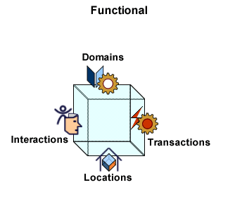
Functional Requirements
Describes what a software system should do
Functional requirements will specify a behavior or function
Based on functional requirements, an engineer determines the behavior (output) that a device or software is expected to exhibit in the case of a certain input.
Example:
A functional requirement for a milk carton would be “ability to contain fluid without leaking”
A system must send an email whenever a certain condition is met (e.g. an order is placed, a customer signs up, etc).

Slide 4

Non-Functional Requirements
Non-functional requirements place constraints on how the system will do so
Elaborates a performance characteristic of the system.
Typically non-functional requirements fall into areas such as:
Performance – for example Response Time, Throughput, Utilization, Static Volumetric
Scalability
Capacity
Availability
Reliability
Recoverability
Maintainability
Serviceability
Security
Regulatory
Manageability
Environmental
Data Integrity
Usability
Interoperability

Slide 5
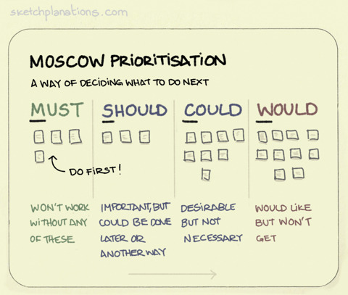
Requirement Priority
Requirements need to be prioritized because stakeholders can’t always have everything they want, or should I say, because we can’t always give them everything they want.
As a BA, how do you ensure you focus on the most important requirements?
The MoSCoW technique is used by analysts and stakeholders for prioritizing requirements in a collaborative fashion.

Slide 6
MoSCoW Example
Human Resource System:
1. Must- Defines a requirement that has to be satisfied for the final solution to be acceptable e.g. The HR system “must” store employee leave history.
2. Should-This is a high-priority requirement that should be included if possible, within the delivery time frame. Workarounds may be available for such requirements and they are not usually considered as time-critical or must-haves. e.g. The HR system “should” allow printing of leave letters.
3. Could- This is a desirable or nice-to-have requirement (time and resources permitting) but the solution will still be accepted if the functionality is not included e.g. The HR system “could” send out notifications on pending leave dates.
4. Would- This represents a requirement that stakeholders want to have, but have agreed will not be implemented in the current version of the system. That is, they have decided it will be postponed till the next round of developments e.g. The HR system “won’t” support remote access but may do so in the next release.

Slide 7
Practical Application
This technique is best used when the BA has gathered all existing solution requirements.
Assemble all stakeholders – Each stakeholder, with help from the BA, is responsible for assigning priorities to the requirements that fall under their purview
All Requirements may be listed on a chart and prioritized by assigning categories to each (M.S.C.W).
If there are multiple stakeholders with different opinions on what category to assign to a requirement, voting can be used to reach consensus.
Present categorized requirements in a readable format
The requirements should be reviewed throughout the project as stakeholder needs may evolve with time.
The BABOK Guide provides 8 criteria to be used for assigning priorities to requirements.
Business Value
Business or Technical Risk
Implementation Difficulty
Likelihood of Success
Regulatory Compliance
Relationship to other requirements
Urgency
Stakeholder Agreement

Slide 8
Requirement Vs Specification
Requirements | Specifications
They outline “what” the software must do | They outline “how” the software will be created
They outline the software from the end-user, business and stakeholder perspective. | They outline the software from the technical team perspective.

Slide 9
Types of Documents
BRD- Business Requirement Documents - What
SRS – System/Software Requirement Specifications - How
FRS - Functional Requirement Specifications - What
BRS - Business Requirement Specification – What
CRS - Compatibility Requirements Specifications
PRS - Performance Requirements Specifications
RRS - Reliability Requirements Specifications
CRS - Configurations Requirements Specification
TDD - Technical Design Document - How
TSD - Technical Specification Document - How
FRD – Functional Requirement Document - What

Slide 10
Types of Documents (Cont..)
BRD: is a requirements package that describes business requirements and stakeholder requirements. BRD is a high level document that contains the entire requirement demanded by the client. The focus of the BRD is to demonstrate the ultimate solution to the business requirement and what steps should be implemented in order to achieve those needs.
SRS: System/Software Requirement Specifications It contains functional and nonfunctional requirements of the Project. Suppose a function is there to add two numbers adding the function is functional requirement the color of the numbers, background color these types of details are non-functional requirements.
(SRS) document is an inclusive explanation of the intended purpose and framework for software under development. SRS describes about the overall functionality of the system. The specification may include a set of use cases that describe interactions the users will have with the software.

Slide 11
Partial example: The “Amazing Restaurant Finder” is a GPS-based mobile application, which helps people to find the closest restaurants based on the user’s current position, price, restaurant type and dish. Users view desired restaurants on a map and get navigation to them. Restaurant owners provide their restaurant information using the web-portal. An administrator of the web-portal verifies restaurant owners and manages user information.
System interfaces- List each system interface and identify the functionality of the software to accomplish the system requirement and the interface description to match the system.
User interfaces-This includes those configuration characteristics (e.g., required screen formats, page or window layouts, content of any reports or menus, or availability of programmable function keys) necessary to accomplish the software requirements.
All the aspects of optimizing the interface with the person who uses, maintains, or provides other support to the system.
Hardware interfaces-Specify the logical characteristics of each interface between the software product and the hardware elements of the system. It also covers such matters as what devices are to be supported, how they are to be supported, and protocols.
Software interfaces-Specify the use of other required software products (e.g., a data management system, an operating system, or a mathematical package), and interfaces with other application systems (e.g., the linkage between an accounts receivable system and a general ledger system).
Communications interfaces- Specify the various interfaces to communications such as local network protocols.

Slide 12
Types of Documents (Cont..)
FRD FRD is the Functional Requirements doc. These are requirements that are written based on the BRD. Through the traceability the FRD can be traced to one or more BRD and vice versa.
FRD is something that must be testable. There is a fine line that you do not get into too much of the how (design) in an FRD. But a tester should be able to look at a FRD and be able to figure out how to test that requirement.
FRS:
(FRS) document specifies the requirements, shaped into functionality and explains how the particular requirement is going to work as a part of proposed system. FRS describes the requested behavior of an engineering system.
Contents:
Specific inputs.
Scope of the system.
Functional behavior of the system.
Defined output of the system.

Slide 13
Difference between BRS & SRS
BRS ( Business Requirement Specification) | SRS (System Requirement Specification)
It describes at very high level the functional specifications of the software | It describes at a high level , the functional and technical specification of the software
It is a formal document describing about the requirement provided by client (written, verbal) | It specifies the functional and non-functional requirements of the software to be developed
Usually its created by the Business Analyst who interacts with clients | Usually it’s created by the System Architect who is a technical expert. Though in smaller companies the BA will create SRS as well. Some companies do not create SRS altogether. Their BRS is detailed enough to be used as SRS as well
It is derived from client interaction and requirements | It is derived from the BRS

Slide 14


